Slide 1
BITS Pilani presentation
Yogesh B
Introduction to DevOps

Slide 2
CSIZG514/SEZG514, Introduction to DevOps
Lecture No. 9 and 10

Slide 3
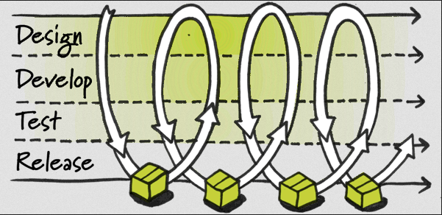
Continuous Delivery
Recall: Build software that is always ready to be deployed into production

Slide 4
Continuous Delivery cont.
Is this a new idea?
1st principle of the Agile Manifesto:
  “Our highest priority is to satisfy the customer through early and continuous delivery of valuable software.“
Goal: Release to production more often
  Monthly
  Weekly
  Daily

Slide 5
Continuous Delivery cont.
Pros: Receive many benefits from the Agile process as well as others
  Build the right product
    Constant feedback from customers
    Write thorough acceptance tests
  Earlier benefits
    Get product out before competitors
    Find bugs earlier

Slide 6
Continuous Delivery cont.
  Ability to react quickly to change
    Not a huge amount of time and money can be abandoned to adopt new requirements
  Save money and time
    Save money and time if project goes bad
    Save money and time with automation
      As deploying to production becomes easier, more time can be spent developing valuable features

Slide 7
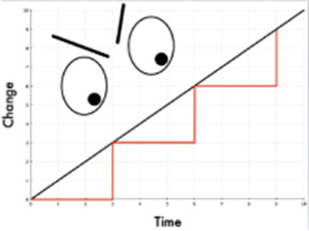
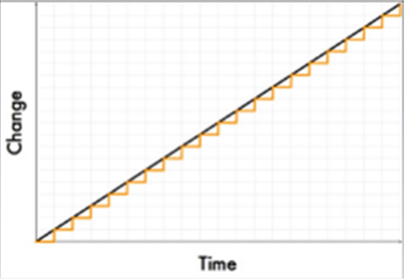
Continuous Delivery cont.
Pros cont:
  Reliability

Slide 8
Practice Continuous Delivery
Basics to start practicing Continuous Delivery
  Configuration Management
  What needs to be kept under CM?
    Everything!
      Code
      Tests
      Configuration Files
      Build Scripts
      Environments
      Documentation
      Etc.

Slide 9
Deployment Pipeline
Heart of Continuous Delivery
Will give immediate feedback for how ready your software is for production
Automate everything(unit tests, acceptance tests, performance tests,…) to the point of just being able to click a button to deploy to production

Slide 10
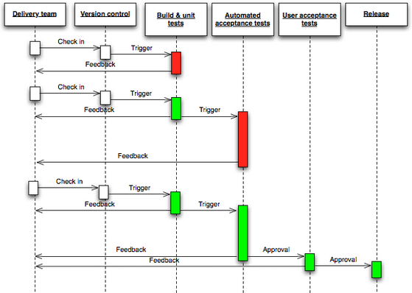
Deployment Pipeline cont.

Slide 11


Automation – Continuous Deployment
  Deployment Automation/Continuous Delivery
    Distributing the components of the releasable package
    into target environment (Dev, Test, Prod)
  Provisioning
    Create and readying the target Env. And middleware required by your application.
  Automated Testing
    Verify:
      Functional
      None functional
  Feedback

Slide 12
Automation – IAC
Infrastructure As A Code
  Put Infra under version control
  History , Melodize your infra
  Deploy monitoring , backups and apps
  IT IS NOT SCRIPTING !
  Think Puppet, Chef, Ansible, Udeploy….

Slide 13
Eight goals of a sytem
1. System must know itself
2. System must be able to reconfigure itself within its operational environment
3. System must pre-emptively optimize itself
4. System must detect and respond to its own faults as they develop
5. System must detect and respond to intrusions and attacks
6. System must know its context of use
7. System must live in an open world
8. System must actively shrink the gap between user/business goals and IT solutions

Slide 14
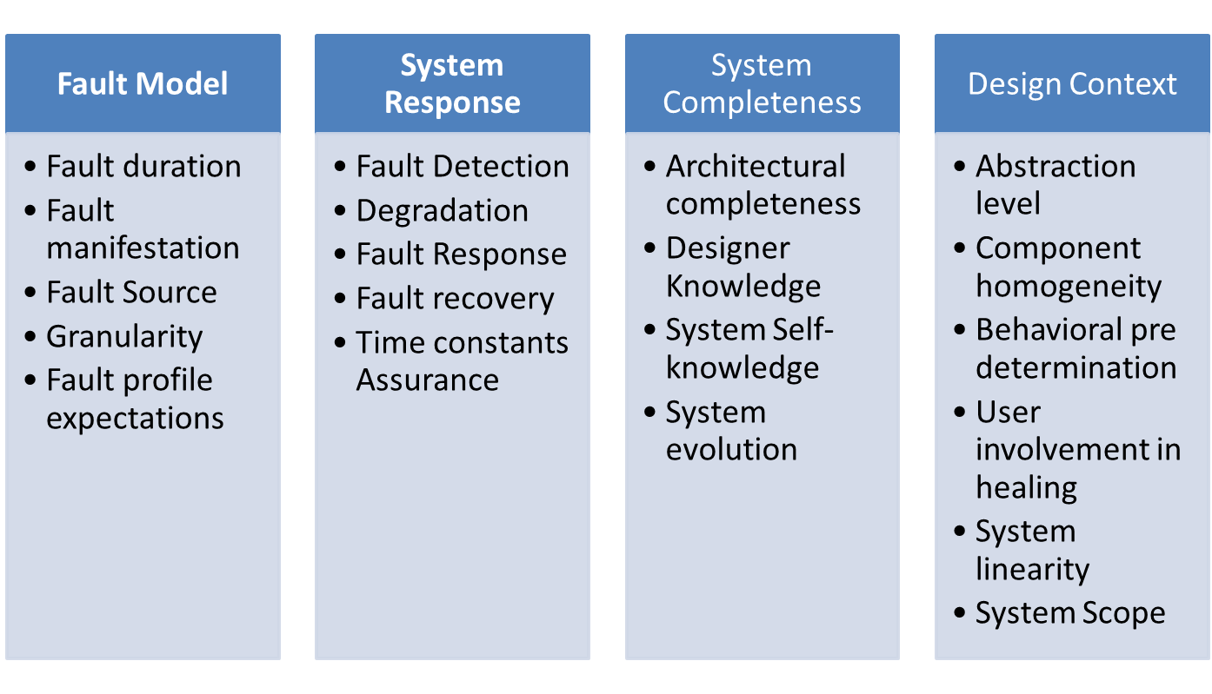
Elements of Self healing

Slide 15
Size of the self healing unit
Component
– Focus on connectors and component discovery
• Service
– Service interfaces, Service discovery, restart
• Node
– Network and interface failures, change to new connection

Slide 16
Architectural approach
• The healing or recovery part often requires reconfiguration and adaptation
• They change the architecture
  – Locate and use alternative component
  – Restart (or rejuvenation or resurrection) the failed component
• Self-healing can be build on reflective middleware

Slide 17
Course Objectives
9 | Continuous Deployment Deployment pipeline Human-free deployments Implementing and Automating the deployment process Deploying it to testing environments | T1- Chapter 6, 12 T2- Chapter 10 R2- Chapter 3, 4
Error Code 725: It works on my machine.
—RFC for HTTP Status Code 7XX: Developer Errors

Slide 18
Problems
Time killers
  Manual testing
  Manual deployment
  Integrations done at the end
Code horror
  Small change requires full regression testing
Release “jams”
  Release packages various from team to team
  On-site participation of 1-2 team members during release

Slide 19



Release “jams”
Team releases
Release manager
PROD
Awaiting teams

Slide 20
Eliminating time killers
  Integrations done at the end
    Automatic builds on commit
    Integration tests
  Manual deployment
    Automatic deployment to DEV (x2) and INT environments from Tools
  Manual testing
    Unit and integration tests
    Functional and UI tests (SoapUI, Selenium)

Slide 21
Eliminating code horror
  Small change requires full regression testing
    Unit tests
    Best to have experienced person in place
    Will require code refactoring
    Separate data storage from the business logic
    Are part of the task DONE criteria
    Integration tests
    Working with DB, Web services, file system, etc.

Slide 22
Eliminating release “jams”
  Unified release packages
    MSBuild scripts with custom tasks
    One-click principle
    Single package for all environments
    Initially takes some time to create, but later is semi- or fully-automatically created on Tools
  Centralized release server
    Single place to deploy packages to remote servers

Slide 23
Deployment
Process of placing a version of a service into production
The initial deployment of a service can be viewed as going from no version of the service to the initial version of the service.
Because an initial deployment happens only once for most systems and new versions happen frequently
Goal of a deployment is to place an upgraded version of the service into production with minimal impact to the users of the system, be it through failures or downtime

Slide 24
Reasons for changing a service
To fix an error
To improve some quality of the service
To add a new feature

Slide 25
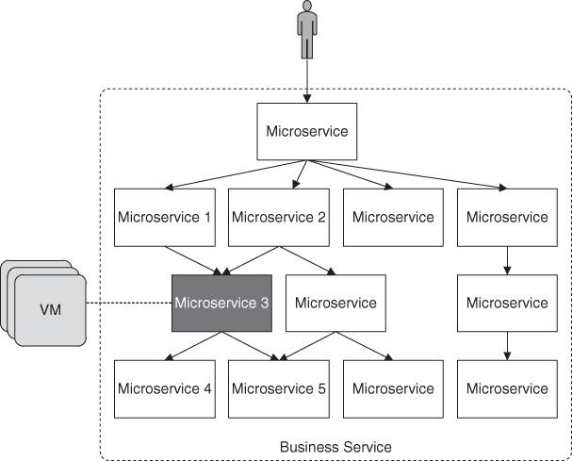
Business Service
Notes:
Also shows the multiple VMs on which the service is running. The number of VMs for a particular service depends on the workload experienced by that service and may grow into the hundreds or even thousands for VMs that must provide for many clients. Each active VM has a single version of the service being deployed, but not all VMs may be executing the same version. The goal of a deployment is to move from the current state that has N VMs of the old version, A, of a service executing, to a new state where there are N VMs of the new version, B, of the same service in execution.

Slide 26
Strategies for managing Deployments
Blue/green deployment (aka big flip or red black)
  consists of maintaining the N VMs containing version A in service while provisioning N VMs of virtual machines containing version B. Once N VMs have been provisioned with version B and are ready to service requests, then client requests can be routed to version B
Rolling upgrade
  A rolling upgrade consists of deploying a small number of version B VMs at a time directly to the current production environment, while switching off the same number of VMs running version A.
Notes:
In order to place an upgraded VM of a service into production, the new version must be loaded onto a VM and be initialized and integrated into the environment, sometimes with dependency on placements of some other services first. This can take on the order of minutes. Consequently, depending on how parallel some actions can be and their impact on the system still serving clients, the upgrade of hundreds or thousands of VMs can take hours or, in extreme cases, even days. Blue/Green
This is a matter of instructing the domain name server (DNS) or load balancer to change the routing of messages. This routing switch can be done in a single stroke for all requests. After a supervisory period, the N VMs provisioned with version A are removed from the
system. If anything goes wrong during the supervisory period, the routing is switched back, so that the requests go to the VMs running version A again. This strategy is conceptually simple, but expensive in terms of both VM and software licensing costs. Long-running requests and stateful data during the switch-over and rollback require special care. The provisioning of the N VMs containing version B prior to terminating all version A VMs is the source of the cost. First, the new VMs must all be provi- sioned. The provisioning can be done in parallel, but the total time for provisioning hundreds of VMs can still be time-consuming. There will be an addi- tional N VMs allocated beyond what is necessary to provide service to clients for the duration of the whole process, including initial provisioning of version B and the supervisory time after fully switching to version B. For this period of time, therefore, the VM-based cost doubles. A variation of this model is to do the traffic switching gradually. A small per- centage of requests are first routed to version B, effectively conducting a canary test. We mentioned canary testing in Chapter 5 and discuss it in more detail in the section “Canary Testing.” If everything goes well for a while, more version B VMs can be provisioned and more requests can be routed to this pool of VMs, until all requests are routed to version B. This increases confidence in your deployment, but also introduces a number of consistency issues.
Rolling Upgrade A rolling upgrade consists of deploying a small number of version B VMs at a time directly to the current production environment, while switching off the same number of VMs running version A. Let us say we deploy one version B VM at a time. Once an additional version B VM has been deployed and is receiving requests, one version A VM is removed from the system. Repeating this process N times results in a complete deployment of version B. This strategy is inexpensive but more complicated. It may cost a small number of additional VMs for the duration of the deployment, but again introduces a number of issues of consistency and more risks in disturbing the current production environment.

Slide 27
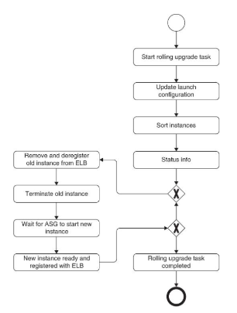
Rolling Upgrade in Amazon Cloud
During a rolling upgrade, one subset of the VMs is providing service with version A, and the remainder of the VMs are providing service with version B. This creates the possibility of failures as a result of mixed versions. ELB (Elastic Load Balancer)
Notes:
Each VM (containing exactly one service for the moment) is decommissioned (removed, deregistered from the elastic load balancer (ELB), and terminated) and then a new VM is started and registered with the ELB. This process continues until all of the VMs containing version A have been replaced with VMs containing version B. The additional cost of a rolling upgrade can be low if you conduct your rolling upgrade when your VMs are not fully utilized, and your killing of one or a small number of VMs at a time still maintains your expected service level. It may cost a bit if you add a small number of VMs before you start the rolling upgrade to mitigate the performance impact and risk of your rolling upgrade

Slide 28
Logical consistency
Assuming that the deployment is done using a rolling upgrade introduces one type of logical inconsistency—multiple versions of the same service will be simultaneously active
Assuming that a service is being deployed without synchronous coordination with its client or dependent services – a second possible source of logical inconsistency—inconsistency in functionality between a service and its clients
3. A third source of logical inconsistency is inconsistency between a service
and data kept in a database.
Notes:
Assuming that the deployment is done using a rolling upgrade introduces one type of logical inconsistency—multiple versions of the same service will be simultaneously active. This may also happen with those variants of the blue/ green deployment that put new versions into service prior to the completion of the deployment

Slide 29
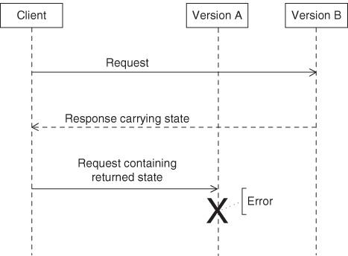
Notes:
Two components are shown—the client and two versions (versions A and B) of a service. The client sends a message that is routed to version B. Version B performs its actions and returns some state to the client. The client then includes that state in its next request to the service. The second request is routed to version A, and this version does not know what to make of the state, because the state assumes version B. Therefore, an error occurs. This problem is called a mixed-
Mixed-version race condition, leading to an error [Notation: UML Sequence Diagram] Several different techniques exist to prevent this situation.
Make the client version aware so that it knows that its initial request was serviced by a version B VM. Then it can require its second request to be serviced by a version B VM.
Toggle the new features contained in version B and the client so that only one version is offering the service at any given time. More details are given below. Make the services forward and backward compatible, and enable the clients to recognize when a particular request has not been satisfied. Again, more details are given below. These options are not mutually exclusive. That is, you can use feature tog- gles within a backward compatible setting. Suppose for example, you make a major reorganization of a service and add new features to it. Within a rolling upgrade you will have installed some VMs of the new version with its reorganization while still not having activated the new features. This requires the new version to be backward compatible. We begin by discussing feature toggling. Feature toggling was introduced in Chapter 5 as a means for deploying partially completed code without it impact- ing the testing process. Here we use the same mechanism for activating new capabilities in an upgrade

Slide 30
Feature Toggling
If services are developed by a single small team, the features of the services will be limited. This means that features are likely to span multiple services. In turn, this means that you must coordinate the activation of the feature in two directions
First, all of the VMs for the service you just deployed must have the service’s portion of the feature activated.
Second, all of the services involved in implementing the feature must have their portion of the feature activated
Feature toggles, can be used to control whether a feature is activated.

Slide 31
Feature Toggling Contd
A feature toggle, to repeat, is a piece of code within an if statement where the if condition is based on an externally settable feature variable. Using this technique means that the problems associated with activating a feature are
Determining that all services involved in implementing a feature have been sufficiently upgraded
Activating the feature in all of the VMs of these services at the same time.
Notes:
Both of these problems are examples of synchronizing across the elements of a distributed system. The primary modern methods for performing such synchronization are based on the Paxos or ZAB algorithms. These algorithms are difficult to implement correctly. However, standard implementations are available in systems such as ZooKeeper, which are not difficult to use. Let us look at how this works from the service’s perspective. For simplicity of description, we assume the service being deployed implements a portion of a single feature, Feature X. When a VM of the service is deployed, it registers it- self as being interested in FeatureXActivationFlag
If the flag is false, then the feature is toggled off; if the flag is true, the feature is toggled on. If the state
of the FeatureXActivationFlag changes, then the VM is informed of this and reacts accordingly. An agent external to any of the services in the system being upgraded is re- sponsible for setting FeatureXActivationFlag. This agent can be a human gate- keeper, or it can be automated. The flag is maintained in ZooKeeper and thus kept consistent across the VMs involved. As long as all of the VMs are in- formed simultaneously of the toggling, then the feature is activated simultaneously and there is no version inconsistency that could lead to failures. The simultaneous information broadcast is performed by ZooKeeper. This particular use of ZooKeeper for feature toggling is often implemented in other tools. For example, Netflix’s Archaius tool provides configuration management for distributed systems. The configuration being managed can be feature toggles or any other property. The agent is aware of the various services implementing Feature X and does not activate the feature until all of these services have been upgraded. Thus, there is no requirement that the services involved be upgraded in any particular order or even in temporal proximity to each other. It could be a matter of days or even weeks before all of the services involved have been modified to implement Feature X. One complication comes from deciding when the VMs have been “sufficiently upgraded.” VMs may fail or become unavailable. Waiting for these VMs to be upgraded before activating the feature is not desirable

Slide 32
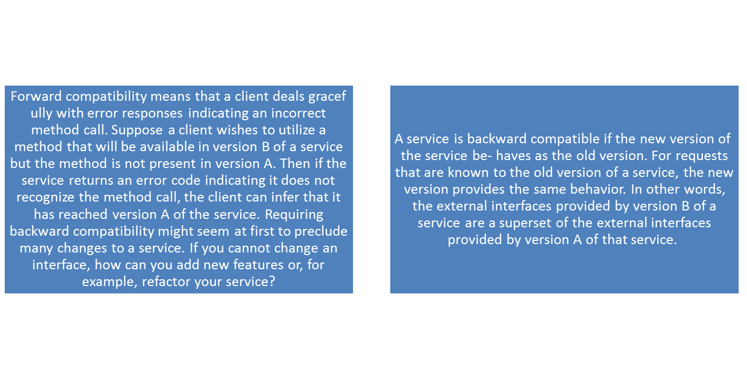
Backward and Forward Compatibility
Using feature toggles to coordinate the various services involved in a new feature is one option for preventing failures as a result of multiple versions

Slide 33
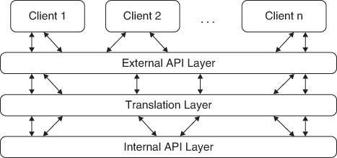
Maintaining backward compatibility
Notes:
The service being upgraded makes a distinction between internal and external interfaces. External interfaces include all of the existing interfaces from prior versions as well as, possibly, new ones added with this version. Internal interfaces can be restructured with every version. In-between the external inter- faces and the internal interfaces is a translation layer that maps the old interfaces to the new ones. As far as a client is concerned, the old interfaces are still available for the new version. If a client wishes to use a new feature, then a new interface is available for that feature. One consequence of using this pattern is that obsolete interfaces may be maintained beyond the point where any clients use them. Determining which clients use which interfaces can be done through monitoring and recording all service invocations. Once there are no usages for a sufficiently long time, the interface can be deprecated. The deprecating of an interface may result in additional maintenance work, so it should not be done lightly. Forward and backward compatibility allows for independent upgrade for services under your control.
Not all services will be under your control. In particular, third-party services, libraries, or legacy services may not be backward compatible. In this case, there are several techniques you can use, although none of them are fool proof.

Slide 34
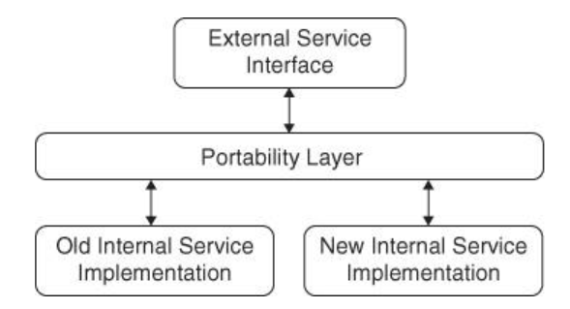
Portability layer with 2 versions of the external system co existing
Notes:
Compatibility with Data Kept in a Database In addition to maintaining compatibility among the various services, some services must also be able to read and write to a database in a consistent fashion. Suppose, for example, that the data schema changes: In the old version of the schema, there is one field for customer address; in the new version, the ad- dress is broken into street, city, postal code, and country. Inconsistency, in this case, might mean that a service intends to write the address as a single field using the schema that has the address broken into portions. Inconsistencies
are triggered by a change in the database schema. Note that a schema can be either explicit such as in relational database management systems (RDBMSs) or implicit such as in various NoSQL database management systems. The most basic solution to such a schema change is not to modify existing fields but only to add new fields or tables, which can be done without affecting existing code. The use of the new fields or tables can be integrated into the application incrementally. One method for accomplishing this is to treat new fields or tables as new features in a release. That is, either the use of the new field or table is under the control of a feature toggle or the services are forward and backward compatible with respect to database fields and tables. If, however, a change to the schema is absolutely required you have two
options: 1. Convert the persistent data from the old schema to the new one. 2. Convert data into the appropriate form during reads and writes. This could be done either by the service or by the database management sys- tem. These options are not mutually exclusive. You might perform the conver- sion in the background and convert data on the fly while the conversion is ongoing. Modern RDBMSs provide the ability to reorganize data from one schema to another online while satisfying requests—although at a storage and performance cost. See Sockt and Iyer cited in Section 6.10 for a discussion of the issues and the techniques used. NoSQL database systems typically do not provide this capability, and so, if you use them, you have to engineer a solution for your particular situation.

Slide 35
Packaging
Packaging components onto a VM image is called baking and the options range from lightly baked to heavily baked
A VM is an image that is running on top of a hypervisor that enables sharing a single bare metal processor, memory, and network among multiple tenants or VMs
The image of the VM is loaded onto the hypervisor from which it is scheduled. A VM image could include multiple independent processes—each a service

Slide 36
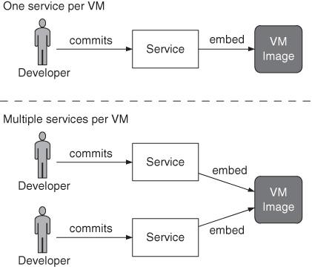
Options for packaging service
Notes:
In the top option, a developer commits a service for deployment, which is embedded into a single VM image. For example, Netflix claims they package one service per VM. In the bottom option, different developers commit different services into a single VM image. The emergence of lightweight containers often assumes one service per container, but with the possibility to have multiple containers per VM
One difference in these two options is the number of times that a VM image must be baked. If there is one service per VM, then that VM image is created when a change in its service is committed. If there are two services per VM, then the VM image must be rebaked whenever a change to either the first or second service is committed. This difference is minor. A more important difference occurs when service 1 sends a message to ser- vice 2. If the two are in the same VM, then the message does not need to leave the VM to be delivered. If they are in different VMs, then more handling and, potentially, network communication are involved. Hence, the latency for messages will be higher when each service is packaged into a single VM. On the other hand, packaging multiple services into the same VM image opens up the possibility of deployment race conditions. The race conditions arise because different development teams do not coordinate over their de- ployment schedules. This means that they may be deploying their upgrades at (roughly) the same time. Our examples below assume the upgraded services are included in the deployed portion of the VM (heavily baked) and not loaded later by the deployed software.

Slide 37
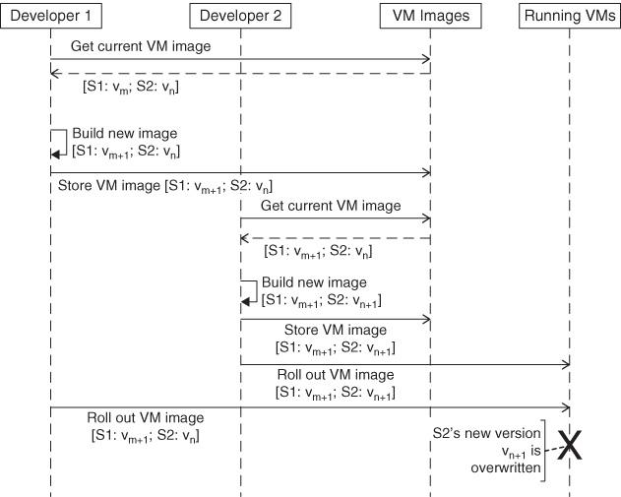
Race condition
One type of race condition when two development teams deploy independently
Notes:
Development team 1 creates a new image with a new version (vm+1) of service 1 (S1) and an old version of service 2 (S2). Development team 2 creates a new image with an old version of service 1 and a new version (vn+1) of service 2. The provisioning processes of the two teams overlap, which causes a deployment race condition

Slide 38
Race condition 2
Notes:
A different type of race condition when two development teams deploy independently [Notation: UML Sequence Diagram]
The tradeoff for including multiple services into the same VM is between re- duced latency and the possibility of deployment race conditions

Slide 39
Deploying to testing and production environments and rolling back—need to form part of your deployment pipeline implementation
It should be possible to see a list of builds available for deployment into each of these environments and run the automated deployment process by pressing a button or clicking a mouse to select the version to deploy and the environment to deploy it to
Notes:
We will be concentrating in this chapter on the problem of deploying application software to environments shared by multiple users, although the same
principles will apply to user-installed software. In particular, we discuss releasing products and ensuring continuous delivery of client-installed software

Slide 40
Creating a release strategy
Parties in charge of deployments to each environment, as well as in charge
of the release
• An asset and configuration management strategy
• A description of the technology used for deployment. This should be agreed
upon by both the operations and development teams
• A plan for implementing the deployment pipeline
• An enumeration of the environments available for acceptance, capacity,
integration, and user acceptance testing, and the process by which builds
will be moved through these environments

Slide 41
Creating a release strategy
• A description of the processes to be followed for deployment into testing
and production environments, such as change requests to be opened and
approvals that need to be granted.
• Requirements for monitoring the application, including any APIs or services
the application should use to notify the operations team of its state.
• A discussion of the method by which the application’s deploy-time and
runtime configuration will be managed, and how this relates to the
automated deployment process.
• Description of the integration with any external systems. At what stage and
how are they tested as part of a release? How do the operations personnel
communicate with the provider in the event of a problem?

Slide 42
Creating a release strategy
• Details of logging so that operations personnel can determine the
application’s state and identify any error conditions.
• A disaster recovery plan so that the application’s state can be recovered
following a disaster.
The service-level agreements for the software, which will determine
whether the application will require techniques like failover and other
high-availability strategies.
• Production sizing and capacity planning: How much data will your live
application create? How many log files or databases will you need? How
much bandwidth and disk space will you need? What latency are clients
expecting?

Slide 43
Creating a release strategy
• An archiving strategy so that production data that is no longer needed can
be kept for auditing or support purposes
• How the initial deployment to production works
• How fixing defects and applying patches to the production environment
will be handled
• How upgrades to the production environment will be handled, including
data migration
• How application support will be managed

Slide 44
Release Plan
The steps required to deploy the application for the first time
How to smoke-test the application and any services it uses as part of the deployment process
The steps required to back out the deployment should it go wrong
The steps required to back up and restore the application’s state
The steps required to upgrade the application without destroying the application’s state
The steps to restart or redeploy the application should it fail
The location of the logs and a description of the information they contain
The methods of monitoring the application
The steps to perform any data migrations that are necessary as part of the release
An issue log of problems from previous deployments, and their solutions
Notes:
There are sometimes other considerations to add. For example, if your new software is taking over from a legacy system, you should document the steps to
transfer users to the new system and decommission the old system, not forgetting a rollback process if things go wrong.
Again, this plan will need to be maintained as the project progresses and new insights are gained

Slide 45
Releasing Products
Pricing model
Licensing strategy
Copyright issues around third-party technologies used
Packaging
Marketing materials—print, web-based, podcasts, blogs, press releases, conferences, etc.
Product documentation
Installers
Preparing sales and support teams

Slide 46
The first deployment
• Your deployment pipeline’s commit stage
• A production-like environment to deploy to
• An automated process that takes the binaries created by your commit stage
and deploys them into the environment
• A simple smoke test that verifies that the deployment worked and the
application is running
Notes:
The first deployment of any application should happen in the first iteration when you showcase your first stories or requirements to the customer. Choose one or
two stories or requirements that are of high priority but very simple to deliver in your first iteration (assuming your iterations are one or two weeks and you
have a small team—you should choose more if these conditions do not apply).
Use this showcase as a reason to make the application deployable to a production like showcase environment (UAT). In our minds, one of the principal goals of
the first iteration of a project is to get the early stages of our deployment pipeline running and to be able to deploy and demonstrate something, no matter how
small, at the end. This is one of the very few situations where we recommend prioritizing technical value over business value. You can think of this strategy as
priming the pump of your development process.
A good question to ask is, “How different is the production environment from my development environment?” If the production environment runs on a different
operating system, you should use the same operating system that will be used in production for your UAT environment. If your production environment is a
cluster, you should build a small, limited cluster for your staging environment.
If your production environment is a distributed one with many different nodes, make sure your production-like test environment has at least one separate process
to represent each class of process boundary.
Virtualization and chicken-counting (0, 1, many) are your friends here. Virtualization
makes it easy to create an environment that represents the important
aspects of your production environment, while being able to run on a single
physical machine. Chicken-counting means that if your production site has
250 web servers, 2 should be enough to represent the significant process
boundaries.

Slide 47
Characteristics of a prod like system
It should run the same operating system as the production system will.
It should have the same software installed as the production system will—and in particular, none of the development toolchain (such as compilers or IDEs) should be installed on it.
This environment should, as far as is reasonable, be managed the same way as the production environment
In the case of client-installed software, your UAT environment should be representative of your clients’ hardware statistics, or at least someone else’s
real-world statistics

Slide 48
Modeling release process and promoting builds
What stages a build has to go through in order to be released (for example,
integration testing, QA acceptance testing, user acceptance testing, staging, production)
What the required gates or approval are
For each gate, who has the authority to approve a build passing through that gate

Slide 49
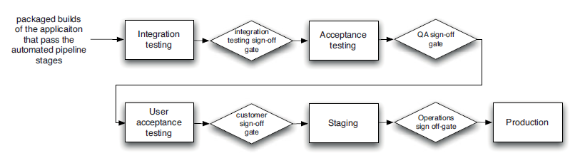
Test and release process diagram

Slide 50
PULL system
The other essential facility that must be provided by the tool you use to manage your deployment pipeline is the ability, for each stage, to see which builds have passed all the previous stages in the pipeline and are hence ready for the next stage.
It should then be possible to choose one of these builds and press a button to have it deployed. This process is known as promotion.
Promoting builds at the press of a button is what turns the deployment pipeline into a pull system, giving everybody involved in the delivery process the ability to manage their own work.
Analysts and testers can self-service deployments for exploratory testing, showcasing, or usability testing.
Operations personnel can deploy any version of their choice to staging or production at the press of a button

Slide 51
Workflow for testing stages
The person or team doing the testing should have a way to select which version of the application they want to deploy into their testing environment. This list will include all versions of the application that have passed all the prior stages of the deployment pipeline. Selecting a particular build should cause the following steps, up to the actual testing, to be performed automatically.
Prepare the environment and associated infrastructure (including middleware) so it is in a clean state, ready for deployment of the application. This should be done in a fully automated fashion
Deploy the application’s binaries. These binaries should always be fetched from the artifact repository, never built from scratch for each deployment.

Slide 52
Workflow for testing stages
Configure the application. Configuration information should be managed in a consistent way across all applications and applied at deployment time or run time, using a tool like Escape
Prepare or migrate any data managed by the application
Smoke-test the deployment
Perform the testing (this might be manual or automated)
If this version of the application passes the tests, approve its promotion to the next environment.
If this version of the application does not pass the tests, record why

Slide 53
Planning at beginning of project
Ensure your production, capacity testing, and staging environments are commissioned. In particular, on a green field project, have your production environment ready some time before the release, and deploy to it as partof your pipeline.
Have an automated process for configuring your environment, including networks, external services, and infrastructure.
Ensure the deployment process is adequately smoke-tested.
Measure the warm-up period for your application. This is especially applicable if your application uses caching. Incorporate this into your deployment plan.
Test integration with external systems. You don’t want your application’s release to be the first time you run against the real external systems.

Slide 54
Planning at beginning of project
If possible, get your application into its production environment well before release. If “release” can be as simple as reconfiguring some router to direct traffic from a holding page to your production environment, so much the better. This technique, known as blue-green deployment, is described a little later in this chapter.
If possible, try rolling your system out to a small group of users before you roll it out to everybody. This technique is known as canary releasing, and is also described later in this chapter.
Deploy every change that passes acceptance tests to your staging environment (although not necessarily to production).

Slide 55
Rolling back deployments &
Zero downtime releases
It is essential to be able to roll back a deployment in case it goes wrong
Debugging problems in a running production environment is almost certain to result in late nights, mistakes with unfortunate consequences, and angry users
You need to have a way to restore service to your users when things go wrong, so you can debug the failure in the comfort of normal working hours

Slide 56
Zero downtime releases AND Rollbacks
Blue-green deployments
Canary releasing
Constraints
The first is your data. If your release process makes changes to your data, it can be hard to roll back.
Another constraint is the other systems you integrate with. With releases involving more than one system (known as orchestrated releases), the rollback process becomes more complex too

Slide 57
Principles for rolling back
The first is to ensure that the state of your production system, including databases and state held on the filesystem, is backed up before doing a release
The second is to practice your rollback plan, including restoring from the backup or migrating the database back before every release to make sure it works

Slide 58
Create the env & deploy from scratch
If you do not have an automated rollback process but you do have an automated deployment process, then redeploying the last version is a fixed time operation that poses a lower risk (because there is less to go wrong).
It is the same process you have tested (hopefully) hundreds of times before. Rollbacks are performed much less frequently, and therefore are more likely to contain bugs

Slide 59
Disadvantages
Even though the time it takes to redeploy the old version is fixed, it is nonzero. It will thus lead to a downtime.
It makes it harder to debug what went wrong. Redeploying the old version often overwrites the new version, thereby removing the opportunity to work out what happened. This can be mitigated if your production environment is virtual, which we describe later on. With relatively simple applications, it’s often easy to keep the old version around by deploying each version to a new directory and using symbolic links to point to the current version.
If you restore from the database backup you took before deploying the latest version, you will lose any data created following the deployment. This may not be a big deal if you roll back reasonably quickly, but in some situations this is not acceptable.

Slide 60
Zero downtime releases
A zero-downtime release, also known as hot deployment, is one in which the
actual process of switching users from one release to another happens nearly instantaneously
It must also be possible to back users out to the previous version nearly instantaneously too, if something goes wrong
The key to zero-downtime releases is decoupling the various parts of the release process so they can happen independently as far as possible
It should be possible to put in place new versions of shared resources your applications depend on, such as databases, services, and static resources, before you upgrade your applications.
Notes:
With static resources and web-based services, this is relatively easy. You just include the version of the resource or service in the URI, and you can have multiple
versions of them available simultaneously. For example, Amazon Web Services has a date-based versioning system, with the latest version of the EC2 API
(at the time of writing) available at http://ec2.amazonaws.com/doc/2009-11-30/ AmazonEC2.wsdl. Of course, they keep the earlier versions of the API working as
well at the old URIs. For resources, when you push a new version of your website out, you put the static resources such as images, Javascript, HTML, and CSS to
a new directory—for example, you could put the images for version 2.6.5 of your application under /static/2.6.5/images. Things are a little harder with databases

Slide 61
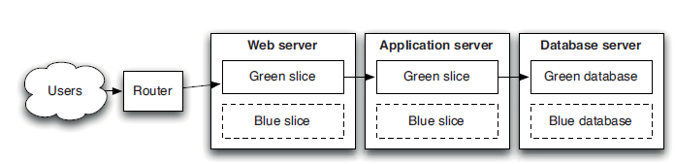
Blue Green Deployments
Notes:
Users of the system are routed to the green environment, which is the currently designated production. We want to release a new version of the application. So we deploy it to the blue environment, and let the application warm up (you can do this as much as you like). This does not in any way affect the operation of the green environment. We can run smoke tests against the blue environment to check it is working properly. When we’re ready, moving to the new version is as simple as changing the router configuration to point to the blue environment instead of the green environment. The blue environment thus becomes production. This switchover can typically be performed in much less than a second.
If something goes wrong, we simply switch the router back to the green environment. We can then debug what went wrong on the blue environment.
It can be seen that this approach yields several improvements over the redeployment approach. However, some care is needed when managing databases with
blue-green deployments. It is usually not possible to switch over directly from the green database to the blue database because it takes time to migrate the data
from one release to the next if there are schema changes.
One way to approach this problem is to put the application into read-only mode shortly before switchover. You can then take a copy of the green database,
restore it into the blue database, perform the migration, and then switch over to the blue system. If everything checks out, you can put the application back into
read-write mode. If something goes wrong, you can simply switch back to the green database. If this happens before the application goes back into read-write
mode, nothing more needs to be done. If your application has written data you want to keep to the new database, you will need to find a way to take the new
records and migrate them back to the green database before you try the release again. Alternatively, you could find a way to feed transactions to both the new
and old databases from the new version of the application
Another approach is to design your application so that you can migrate the database independently of the upgrade process,
If you can only afford a single production environment, you can still use blue green deployments. Simply have two copies of your application running side by
side on the same environment. Each copy has its own resources—its own ports, its own root on the filesystem, and so forth—so they can both be running simultaneously without interfering with each other. You can deploy to each environment independently. Another approach would be to use virtualization, although you should first test the effect of virtualization on the capacity of your application.
If you have a sufficient budget, your blue and green environments can be completely separate replicas of each other. This requires less configuration, but
is of course more expensive. One variant of this approach, known as shadow domain releasing, shadow environment releasing, or live-live releasing, is to use
your staging and production environments as your blue and green environments.
Deploy the new version of your application to staging, and then switch users from production to the staging environment to send the new version of your
application live. At this point, staging becomes production, and production becomes staging.

Slide 62
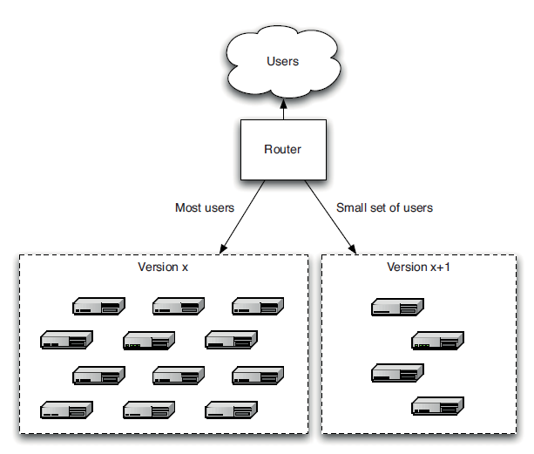
Canary Releasing
Canary releasing, involves rolling out a new version of an application to a subset of the production servers to get fast feedback. Like a canary in a coal mine, this quickly uncovers any problems with the new version without impacting the majority of users. This is a great way to reduce the risk of releasing a new version
Notes:
It is usually a safe assumption that you only have one version of your software in production at a time. This makes it much easier to manage bugfixes, and indeed
your infrastructure in general. However, it also presents an impediment to testing your software. Even with a solid and comprehensive testing strategy, defects
pop up in production. And even with a low cycle time, development teams could still benefit from faster feedback on the new features and whatever they
could be doing to make their software more valuable.
Furthermore, if you have an extremely large production environment, it’s impossible to create a meaningful capacity testing environment (unless your application’s architecture employs end-to-end sharing). How do you ensure a new version of your application won’t perform poorly?
Canary releasing aims to address these challenges.
Canary releasing, involves rolling out a new version of an application to a subset of the production servers to get fast feedback. Like a canary in a coal mine, this quickly uncovers any problems with the new version without impacting the majority of users. This is a great way to reduce the risk of releasing a new version

Slide 63
Benefits of Canary Releasing
1. It makes rolling back easy: Just stop routing users to the bad version, and you can investigate the logs at your leisure.
2. You can use it for A/B testing by routing some users to the new version and some to the old version. Some companies measure the usage of new features, and kill them if not enough people use them. Others measure the actual revenue generated by the new version, and roll back if the revenue for the new version is lower. If your software generates search results, you might compare the quality of the results obtained by real users in the new version versus the old version. You don’t need to route a large number of users to the new version to do A/B testing; a representative sample is sufficient.

Slide 64
Benefits of Canary Releasing
3. You can check if the application meets capacity requirements by gradually ramping up the load, slowly routing more and more users to the application and measuring the application’s response time and metrics like CPU usage, I/O, and memory usage, and watching for exceptions in logs. This is a relatively low-risk way to test capacity if your production environment is too large to create a realistic production-like capacity testing environment
Notes:
Canary releasing is not the only way to do A/B testing—you can, instead, use switches in your application to route different users to different behavior. Alternatively, you could use runtime configuration settings to change behavior. However, these alternatives don’t provide the other benefits of canary releasing.
Canary releasing is not for everyone, though. It is harder to use it where the users have your software installed on their own computers. There is a solution
to this problem (one used in grid computing)—enable your client software or desktop application to automatically update itself to a known-good version
hosted by your servers.
Canary releasing imposes further constraints on database upgrades (which also apply to other shared resources, such as shared session caches or external services):
Any shared resource needs to work with all versions of the application you want to have in production. The alternative approach is to use a shared-nothing architecture where each node is truly independent of other nodes, with no shared database or services, or some hybrid of the two approaches
Finally, it is important to keep as few versions of your application in production as possible—try to limit it to two. Supporting multiple versions is painful, so
keep the number of canaries to a minimum

Slide 65
Dealing with defects in PROD
Never do them late at night, and always pair with somebody else.
Make sure you have tested your emergency fix process.
Only under extreme circumstances circumvent the usual process for making changes to your application.
Make sure you have tested making an emergency fix using your staging environment.
Sometimes it’s better to roll back to the previous version than to deploy a fix. Do some analysis to work out what the best solution is. Consider what happens if you lose data or face integration or orchestration problems

Slide 66
Assumptions
1. Service to the clients should be maintained while the new version is being deployed. Maintaining service to the clients with no downtime is essential for many Internet e-commerce businesses. Their customers span the globe and expect to be able to transact business around the clock. Certainly, some periods of a day are going to be busier than others, but service must be available at all times. Organizations that have customers primarily localized in one geographic area can afford scheduled downtime—but why have downtime if it is avoidable? Scheduled off-hours during downtime requires system administrators and operators to work in the off-hours. This is another reason to avoid downtime.
2. Any development team should be able to deploy a new version of their service at any time without coordinating with other teams. This may certainly have an impact on client services developed by other teams. We have previously discussed the relationship between synchronous co- ordination of development teams and the time to release new features. Allowing a development team or individual developer to release a new version of their service without coordinating with teams developing client services removes one cause for synchronous coordination.

Slide 67
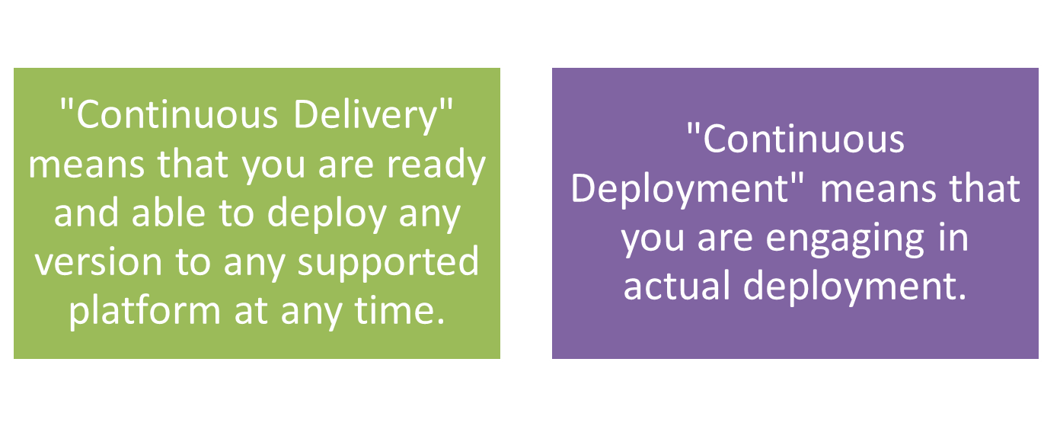
CD vs CD?
Notes:
The phases in the Solution Delivery Pipeline lead you through a shortened cycle in order to be fast in response. For example, the planning phase is accelerated in that you plan just enough to get to the next 2-week Sprint. Contrast this with the traditional way of spending a lot of time planning for the entire project, which usually results in testing, scalability, and QA getting squeezed and ultimately a less-than-optimum product being released.
In shortening the cycle, it's imperative to incorporate feedback loops in order to get useful information that enables you to learn and improve. Feedback is achieved by collecting metrics at each phase-plan, code, build, test, release, and so on, so the development team can improve the next integration.
Being Agile
Working in an Agile environment, you constantly learn from small pieces of work and thereby are able to make improvements before actual deployment.
Planning for short cycles, such as 2-week Sprints, allows you to have a smaller bit to review and improve. By incorporating feedback loops along the way you are given important information that illuminates what works and what doesn't work in order to make corrections quickly. Being agile means you can have the infrastructure keep up with changes and match the application development cadence in order to avoid deploying on the "wrong" infrastructure.
An Agile environment requires automating the testing phase so it happens fast and provides accurate feedback and can keep up with a Continuous Delivery pace. An agile response comes into play for issues that are reported through the help desk and other user input channels.

Slide 68
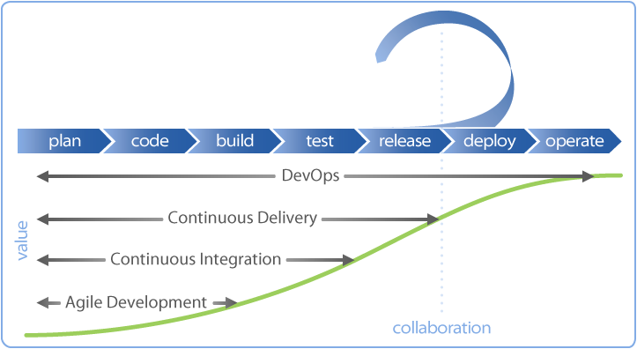
Phases in Solution Delivery Pipeline

Slide 69
Continuous Delivery
Process improvement questions
Did you finish what you thought you would finish?
Did you estimate properly?
Did it take the same amount of time you thought it would take?
Were the tasks done the actual tasks the team had to complete during Sprint execution?
Were there a lot of tasks that had to be done that were not planned?
In looking at Continuous Delivery, the preferred goal is to be ready and able to deploy 10 or more times per day. If you hit that goal, then deployment can be done every 45 minutes

Slide 70

Continuous deployment
  Continuous, successful and repeatable methodology to deploying code

Slide 71





Who is doing?
  WordPress.com
    “Everyone has access to a deploy button”
    “Deployment to 400 production servers in our web tier in less than 30 seconds”
  Facebook
  Flickr
  Atlassian
  others...
Notes:
There are a number of big proponents of Continuous Deployment, these are just a few that I can easily name off the top of my head because they're so outspoken about it.
In reality, there are more organizations practicing some variation or form continuous deployment than you might realize.
I'm not here to be the final arbiter of what is and is not Continuous Deployment, I merely wanted to get a loose understanding of it under our belts before we continue

Slide 72
Continuous Deployment
Continuous Deployment is actually deploying; however, it doesn't mean you must deploy to production or to the customer every time. For example, you can deploy to QA or to a deployment slot. A deployment slot is an A/B deployment method that allows you to get valuable information without inconveniencing users in the event that a defect leaks through a gap in the testing process. This takes some of the fear and anxiety out of the deployment.
One way of deploying to a slot might be to offer an "opt-in" choice for the customer to get an updated version, providing you with a smaller group of users that can serve as a "beta." You always give these users the ability to go back to the former version if they want to do so.

Slide 73
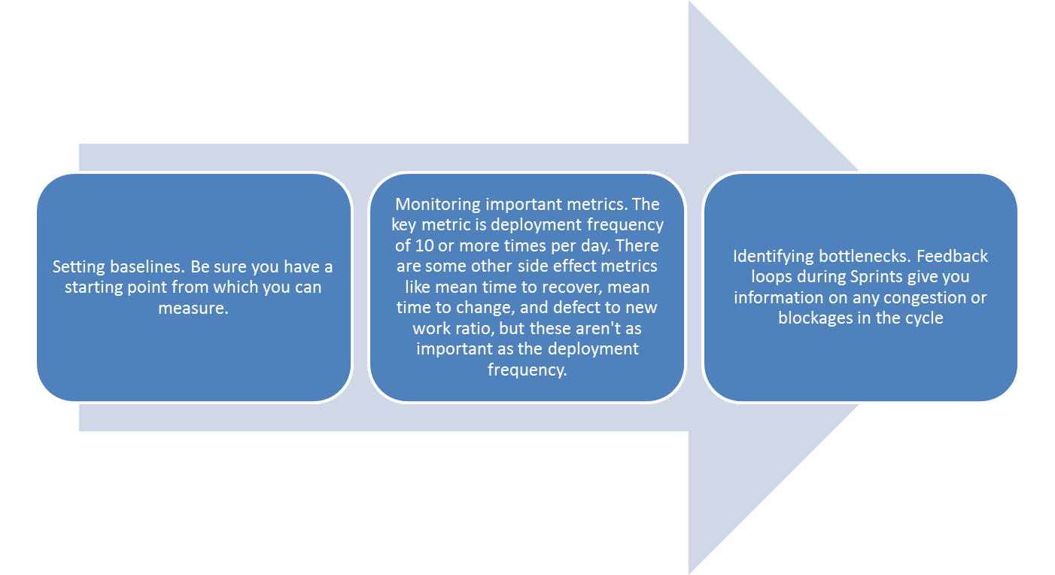
Continuous Improvement
Continuous Improvement requires that you amplify feedback loops by:

Slide 74
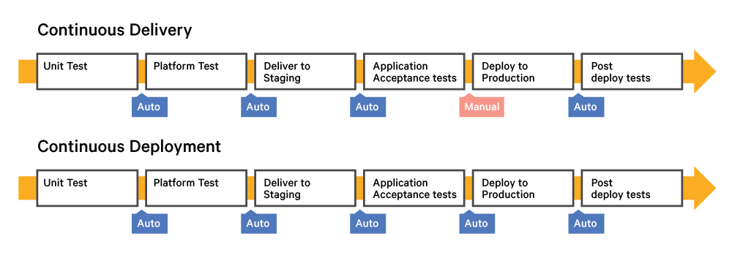
Delivery vs Deployment
Notes:
With Continuous Delivery, "Deploy to Production" is a manual process, meaning that it is initiated manually. This differs from Continuous Deployment, which is automated all the way through "Post Deployment Test."
In summary, Continuous Delivery is a state of being ready and able to release any version at any time on any platform, whereas Continuous Deployment is being able to continually deploy. Both require an Agile process that provides a framework where you work on small, frequent changes and obtain feedback. Both require that you continually learn and improve on what you have done. And, both require open communication throughout the process. Achievement means you can ultimately bring needed value to your customers

Slide 75
Continuous Deployment
if it hurts, do it more often—the logical extreme is to deploy every change that passes your automated tests to production
I take my pipeline and make the final step—deployment to production—automatic. That way, if a check-in passes all the automated tests, it gets deployed directly to production
Continuous deployment can be combined with canary releasing by using an automated process that rolls out a new version to a small group of users first, rolling it out to all users once it has been determined (probably as a manual step) that there are no problems with the new version. The added safeguards provided by a good canary releasing system make continuous deployment an even less risky proposition.
Notes:
Continuous deployment isn’t for everyone. Sometimes, you don’t want to release new features into production immediately. In companies with constraints on
compliance, approvals are required for deployments to production. Product companies usually have to support every release they put out. However, it certainly
has the potential to work in a great many places. The intuitive objection to continuous deployment is that it is too risky. But, as we have said before, more frequent releases lead to lower risk in putting out any particular release. This is true because the amount of change between releases goes down. So, if you release every change, the amount of risk is limited just to the risk inherent in that one change. Continuous deployment is a great way to
reduce the risk of any particular release.
Perhaps most importantly, continuous deployment forces you to do the right thing (as Fitz points out in his blog post). You can’t do it without automating
your entire build, deploy, test, and release process. You can’t do it without a comprehensive, reliable set of automated tests. You can’t do it without writing
system tests that run against a production-like environment. That’s why, even if you can’t actually release every set of changes that passes all your tests, you
should aim to create a process that would let you do so if you choose to.

Slide 76
Continuously Releasing User-Installed Software: Issues
Managing the upgrade experience
Migrating binaries, data, and configuration
Testing the upgrade process
Getting crash reports from users

Slide 77
Upgrade process by clients
Have your software check for new versions and prompt the user to download and upgrade to the latest version. This is the easiest to implement, but the most painful to use. Nobody wants to watch a download progress bar
Download in the background and prompt for installation. In this model, your software periodically checks for updates while running and downloads them silently. After the download is successful, it keeps prompting the user to upgrade to the latest version
Download in the background and silently upgrade the next time the application is restarted. Your application might also prompt you to restart now if you’d like to upgrade (as Firefox does)

Slide 78
Tips & Tricks
The People Who Do the Deployment Should Be Involved in Creating the Deployment Process
Log Deployment activities
Don’t Delete the Old Files, Move Them
Deployment Is the Whole Team’s Responsibility
Server Applications Should Not Have GUIs
Have a Warm-Up Period for a New Deployment
Fail Fast
Don’t Make Changes Directly on the Production Environment

Slide 79
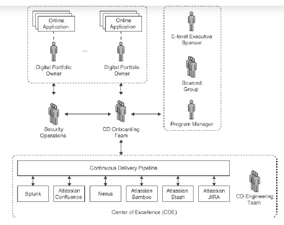
Project team structure

Slide 80
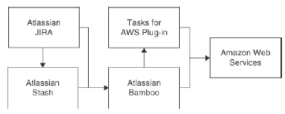
The CDP continuous deployment pipeline
Notes:
gives an overview of the tools that form the CDP and their interactions. Information from Atlassian JIRA (the ticketing system) is fed both to Atlassian Stash (the source code revision system) and to Atlassian Bamboo (the continuous deployment system). Stash provides application and configuration source code for Bamboo to build images, which Bamboo then deploys onto AWS. Since Bamboo does not natively interact with AWS, it utilizes the commercial plug-in “Tasks for AWS.”
Two essential elements of any CDP are a source repository and the
continuous integration/deployment (CI/CD) tool. A wide range of open
source, hosted, and commercial source repositories exist in the market,
but enterprises generally have regulatory concerns or IP protection
requirements that dictate the use of behind-the-firewall solutions such as
Atlassian Stash or GitHub Enterprise. Sourced Group uses Atlassian
Bamboo as the CD tool of choice, which forms the backbone of the CDP.
Atlassian Bamboo offers several key features that are important to an
enterprise CDP, such as tight integration with ticketing and audit trails
systems, but its unique branch management is critical to the objectives of
the CDP as we discuss next.
A core feature of the CDP is its enforcement of a standardized application life cycle, along with the assurance benefits that leads to. That life cycle is
defined as a (software) plan that is executed in conjunction with the source control system. In order to provide assurance, it is essential that
the same life cycle (or plan) is used on a feature or testing branch and on the mainline or integration branch. Atlassian Bamboo achieves this by
supporting branch awareness in plans, allowing the execution of copies of the plan against an arbitrary number of source branches. The branches
are automatically detected and cleaned, further reducing human effort.

Slide 81
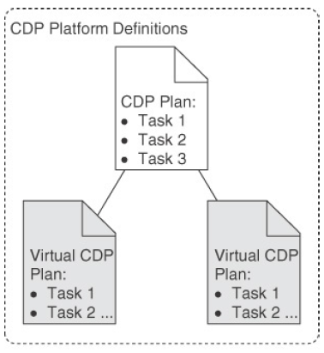
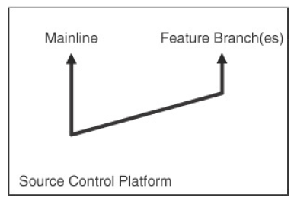
Virtual Plans for branches
Notes:
This is in contrast to many CD systems that manage each branch as a different plan. As demonstrated in Figure 12.4, managing each branch as a different plan creates a point of administration and inevitably leads to drift between the plans, which in turn results in the loss of standardization and assurance.

Slide 82
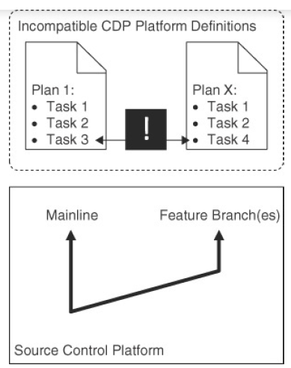

Slide 83
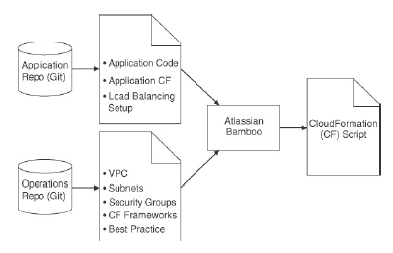
Merging operations templates and application configuration into a single CF script
Notes:
Figure 12.5 shows the CF merging process. A template for the application at hand is merged with independent operations templates to create a
single template that is used in the baking process. The operations templates include the perimeter security group (responsible for
preventing external access to the organization’s virtual private cloud (VPC)) and the network security group (responsible for security within
the network inside the VPC perimeter). These and other templates are merged in a priority fashion, so that an application template cannot
override settings specified by one of the operations templates. Operations templates are stored in one Git repository, and application templates are stored in another. This provides greater levels of control single CF template.
The merge of separate CF templates also enables the implementation of controls outlined in the enterprise security policy. In particular, the
requirements on different components based on the security policy can be specified, and the fulfillment of those requirements can be implemented
centrally, as so-called “units of consumption.” For example, if the enterprise has a requirement that all S3 (Simple Storage Service) buckets
are logged and version control enabled, and if the application’s CF template uses S3 buckets, then, in the merged CF template, the standard
S3 buckets are replaced with a version that has been built on top of the standard offering but fulfills those requirements. This extended version is
built by the CD engineering team in cooperation with SecOps. Therefore, by consuming the S3 “unit” they are, by definition, compliant.

Slide 84
Thank You!
In our next session:

